Slide 1
DSA
-
Deep Learning [3]
Advanced Neural Networks, Part 2

Slide 2
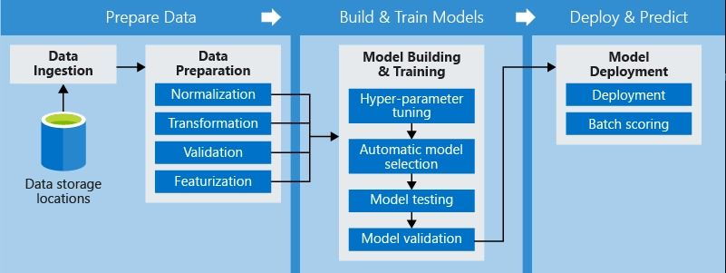
Firstly, a recap on the ML pipeline

Slide 3
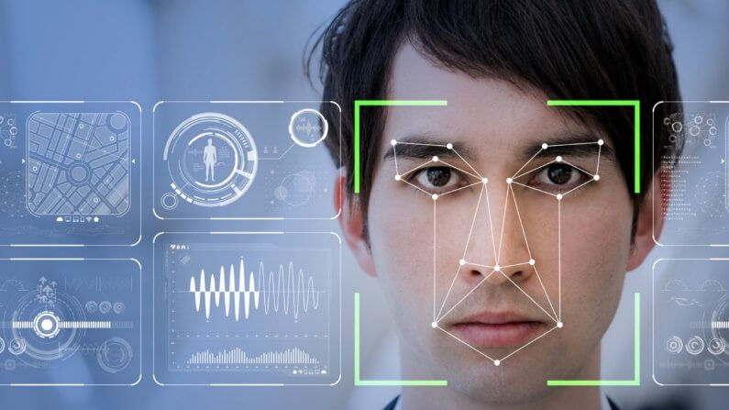
Goal: code a Neural Network to recognize facial expressions using our webcam

Slide 4
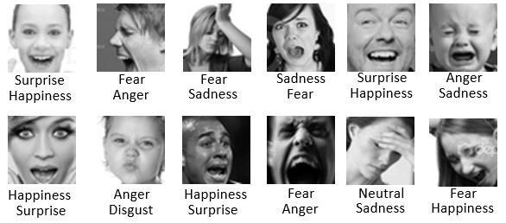
Dataset: FER-2013

Slide 5
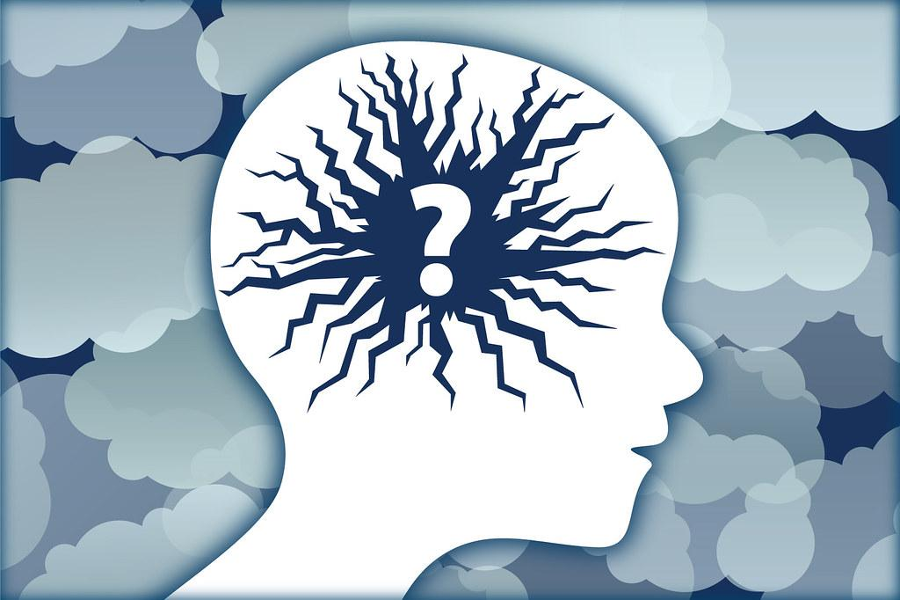
What were the flaws of our previously trained model?

Slide 6
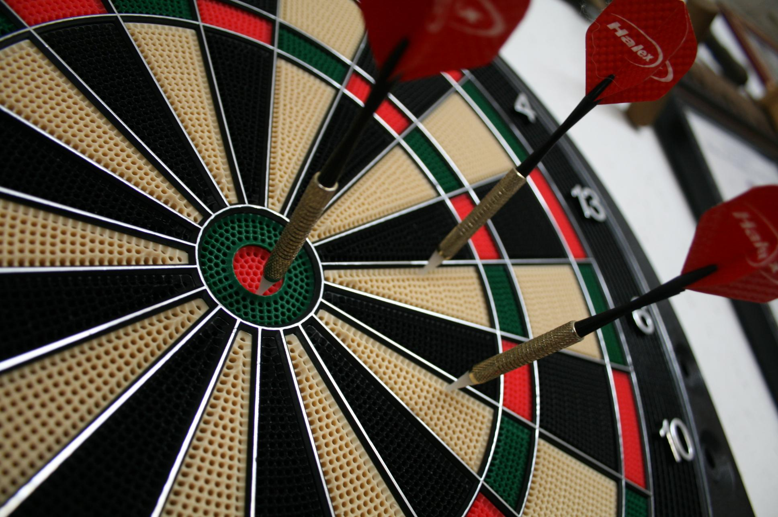
Thus, we will improve the model’s accuracy

Slide 7
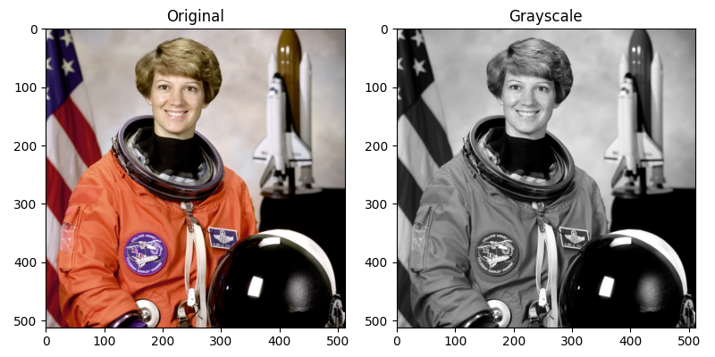
Convert Grayscale to RGB

Slide 8
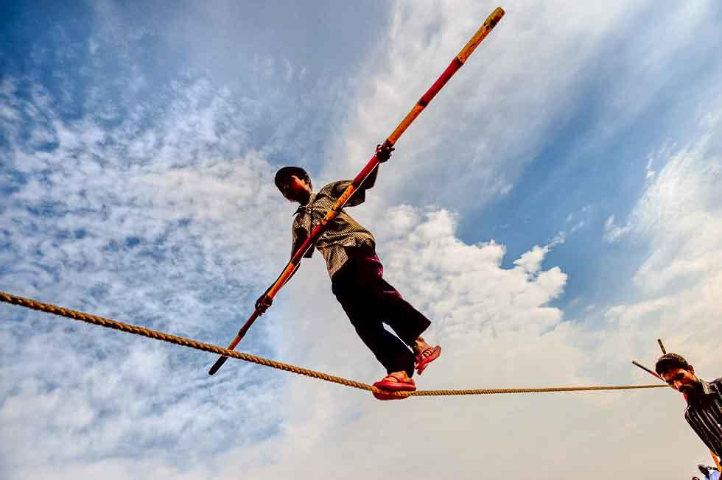
Balance Class Weights

Slide 9
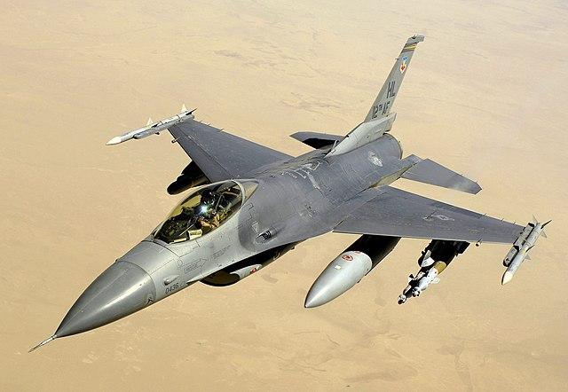
Data Generators

Slide 10
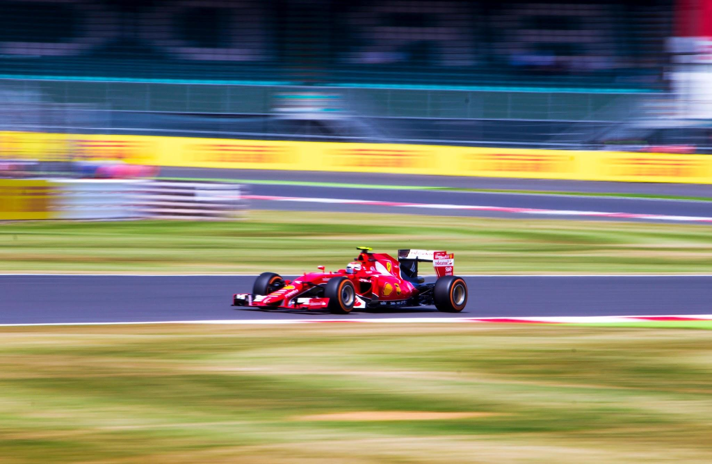
Reduce Overfitting

Slide 11
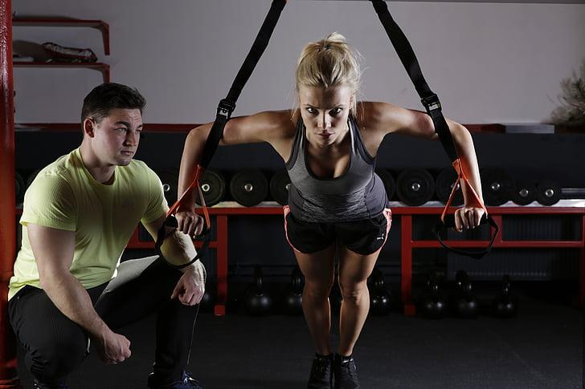
Train model for longer

Slide 12
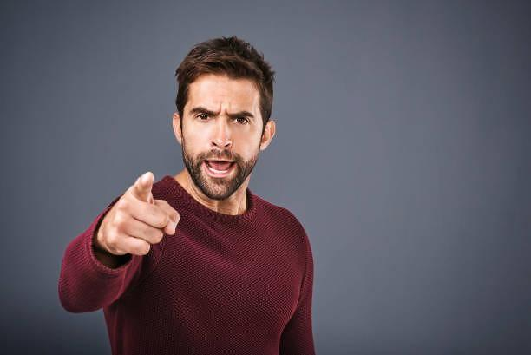
Trade-off: Accuracy vs Speed/Cost

Slide 13
Let’s CODE!!!

